Slide 1
River Pollution Monitoring System ---- AquaSense
John WU
Felix FAN

Slide 2
0. Content
01
Background
02
Current Methods
03
Novel Solution
Schedule and Challenges
04
05
Conclusion

Slide 3
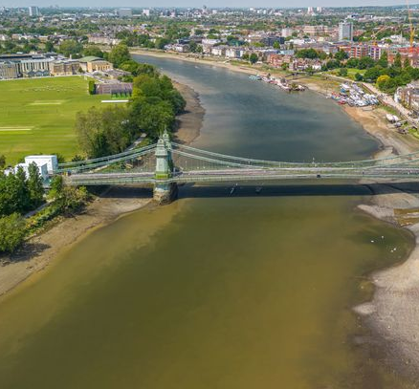
1. Background
River Pollution in London
River test samples:
92% samples -> coliform bacteria; 1% samples -> low dissolved oxygen [2].
Impact of Coliform on Residents:
Cause intestinal infection, vomiting, etc [3].
Our Objectives:
Real-time detecting;
Locating contamination
Fig. 1. Levels of E.coli were found around Hammersmith Bridge in west London [1]

Slide 4
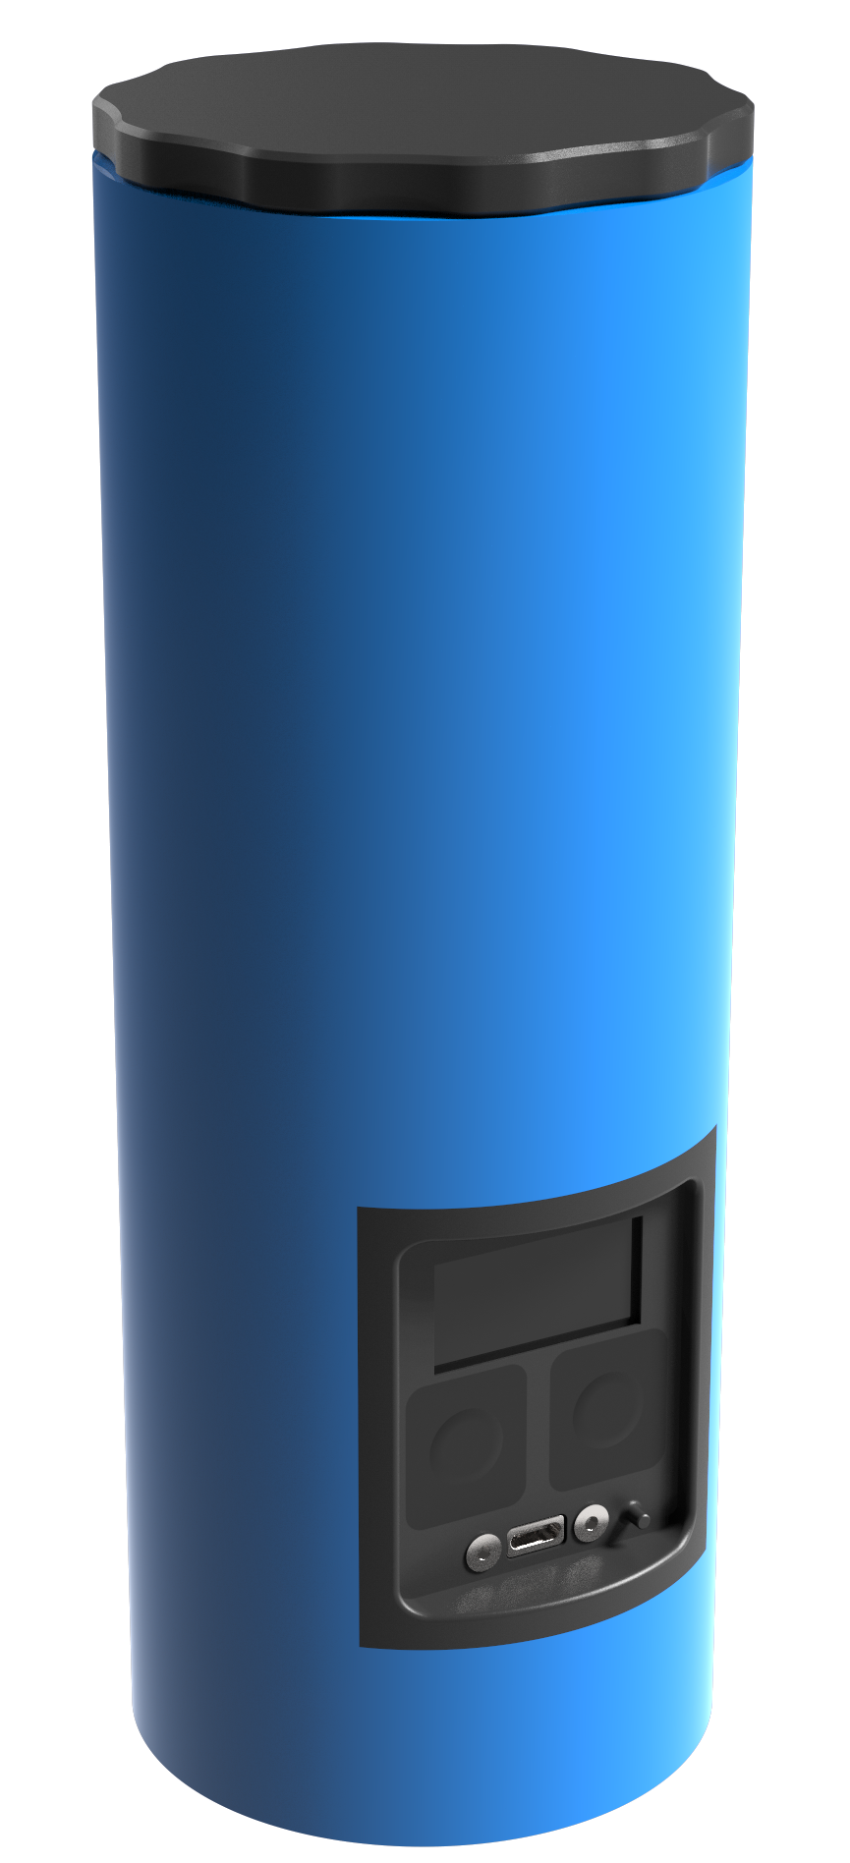
2. Current Methods
Current Methods
Test in laboratories
handheld E.coli detection (operation time = 2 hours) [4].
Limitation
Large-scale manual sampling
Difficulty updating data
High economic cost
Fig. 2. E. Coli analyzer [4]

Slide 5
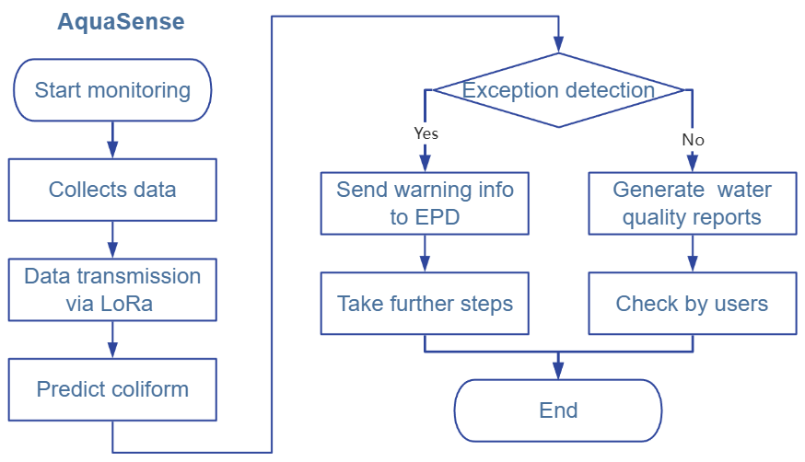
3. Novel IoT Solution
Innovations on IoT
Real-time monitor and analysis
Multi-device co-work
Combine ML with pollution monitoring

Slide 6
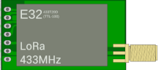
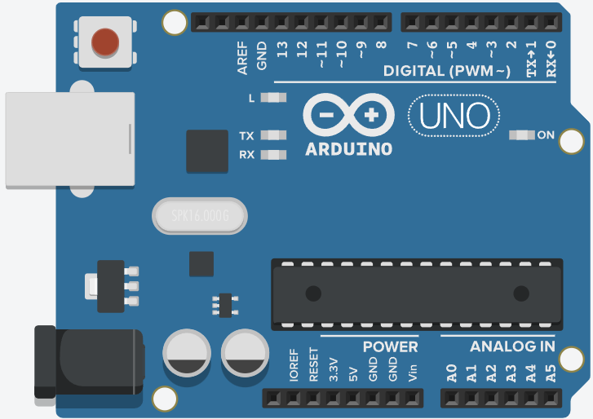

3. Novel Solution
pH sensor
SCC
Analog Signal
LORA transmission
Power Supply
TTL Connection
Turbidity sensor
SCC
TDS sensor
SCC
Arduino UNO
EC sensor
SCC
DO sensor
SCC
RTC
LORA
Arduino with sensors
Terminal equipment
Fig. 3. Schematic diagram of data transfer
Fig. 4. Block Diagram of sensor

Slide 7
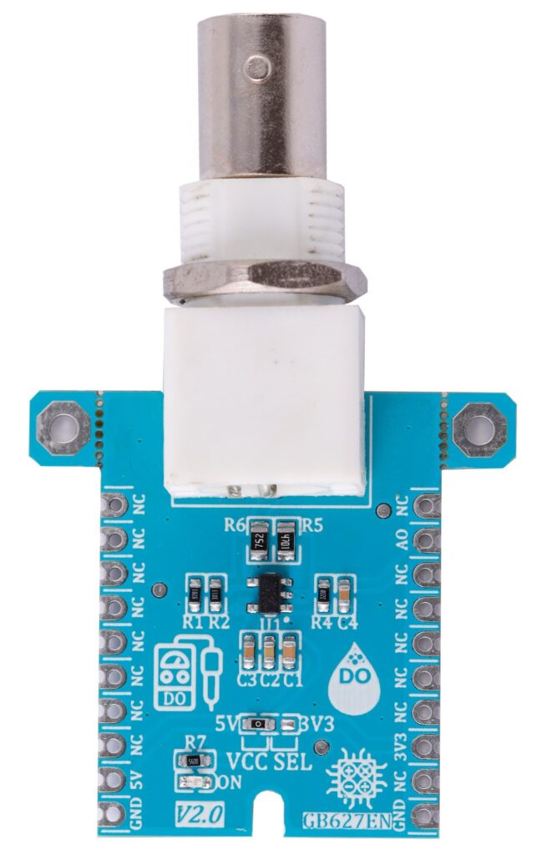
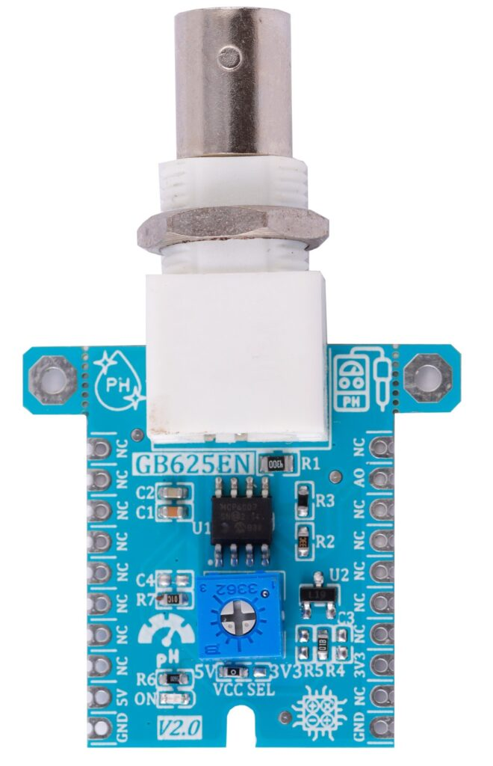
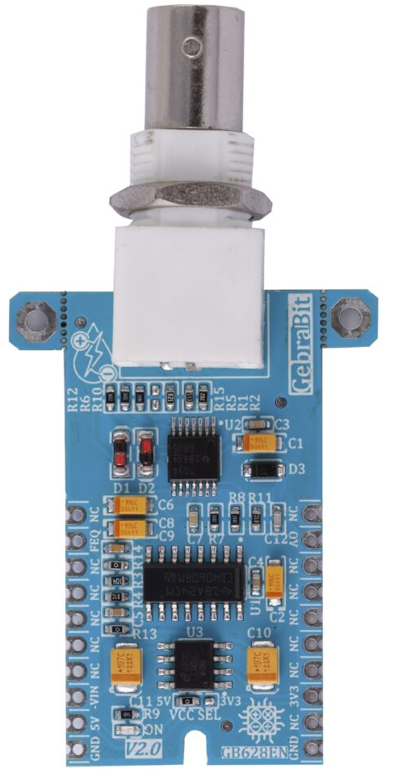
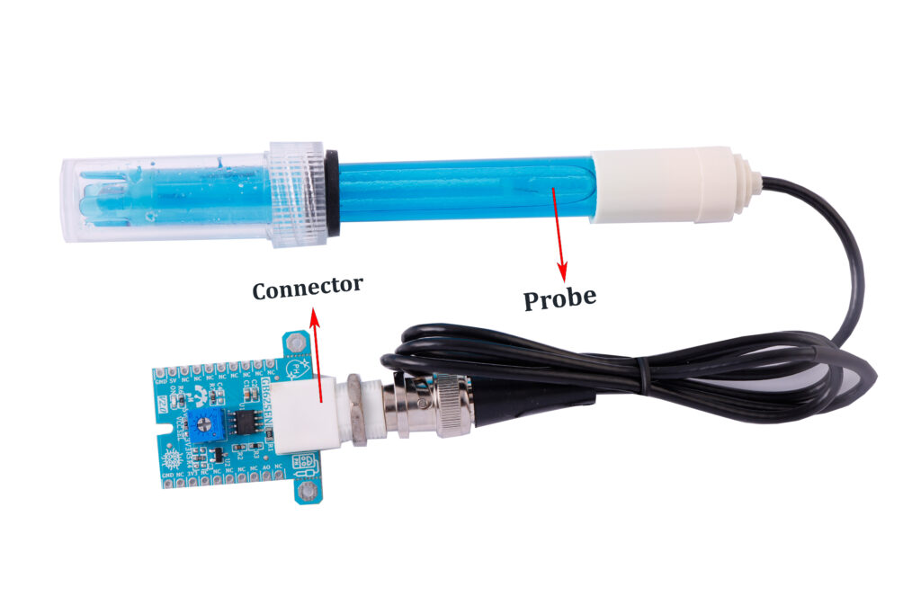
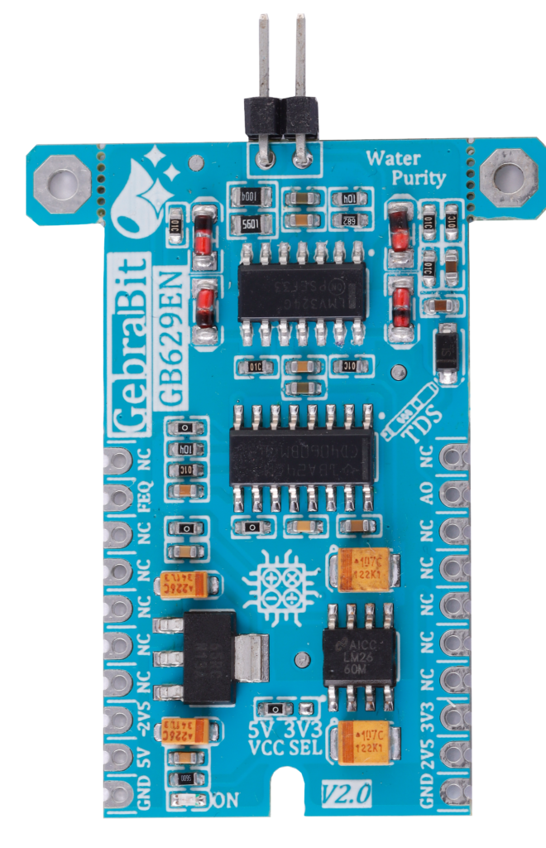
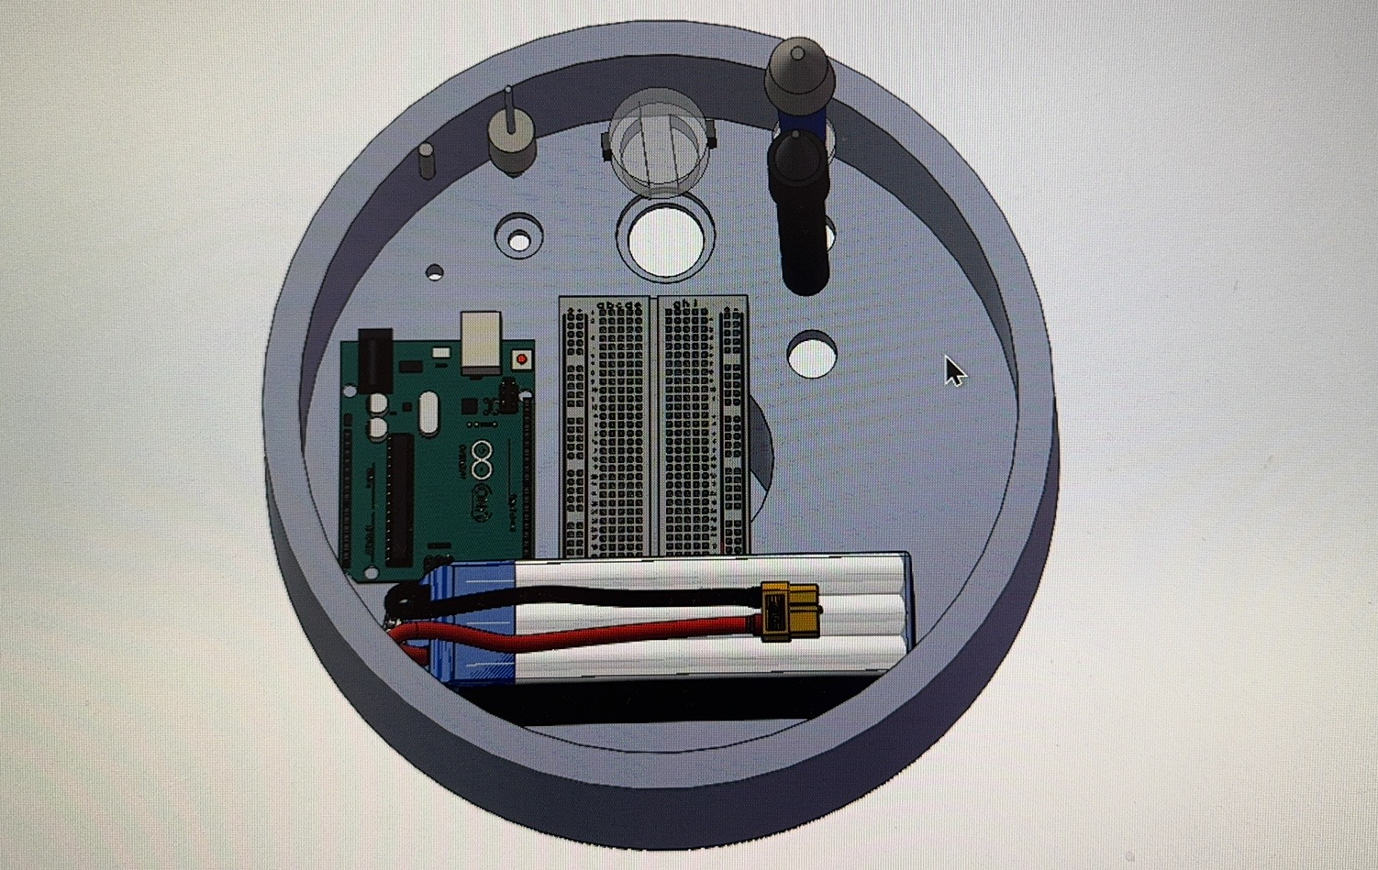
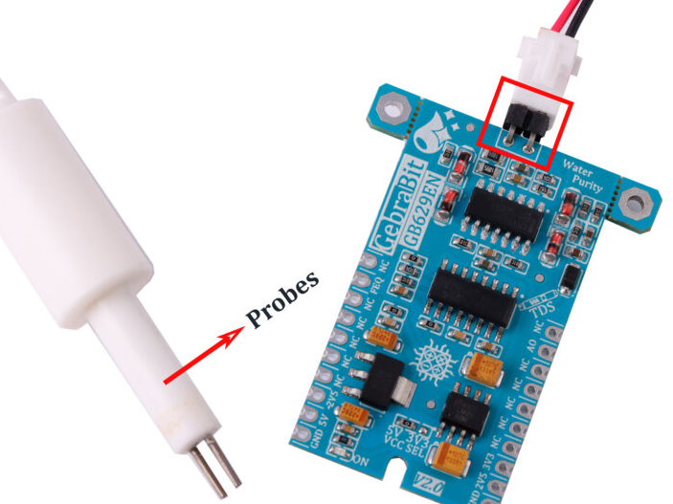
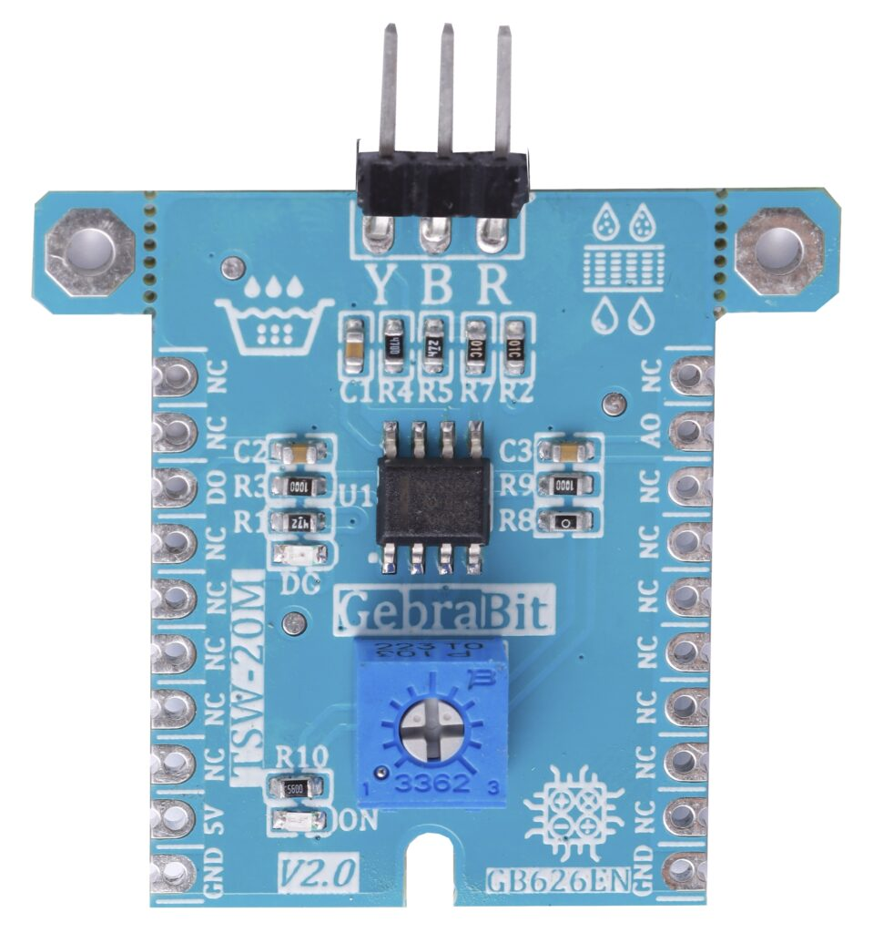
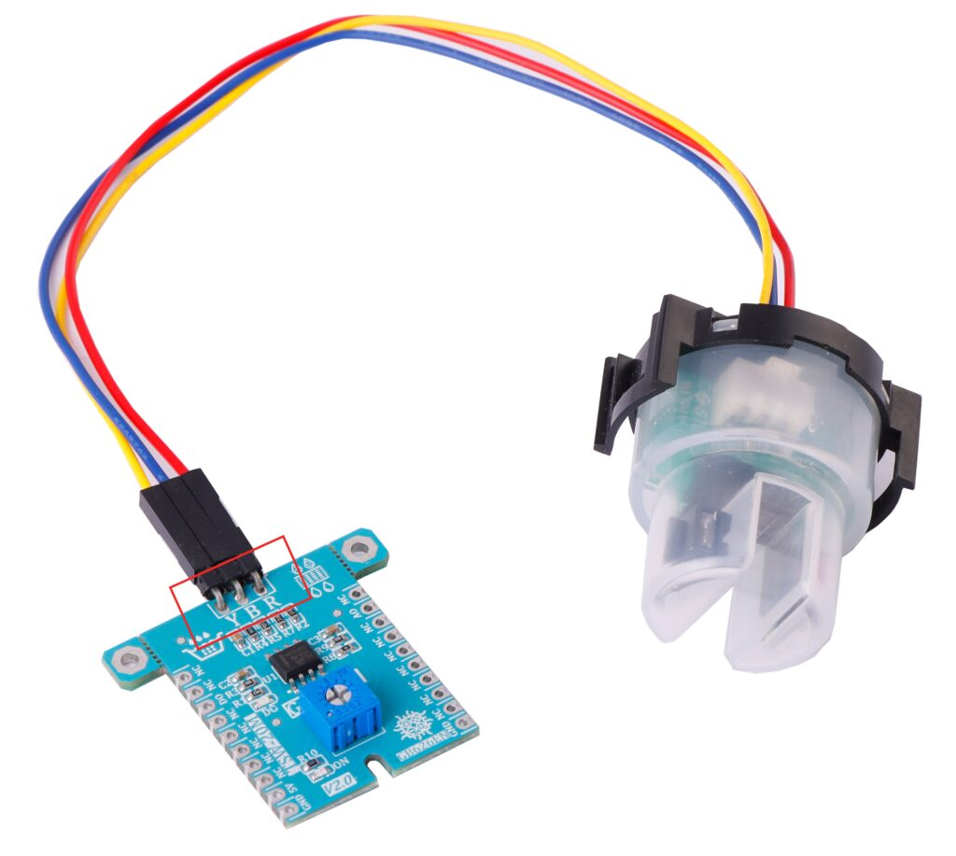
3. Novel Solution
DO sensor module
pH sensor module
EC sensor module
TDS sensor module
TSW-20M module

Slide 8
3. Novel Solution
Advantages of applying IoT devices
Utilizing IoT-based system has 3 main advantages .
Using Arduino platform -> strong expansibility and flexibility,
Using cheap components -> lower cost,
Use remote monitoring based on Wi-Fi -> convenient,
……

Slide 9
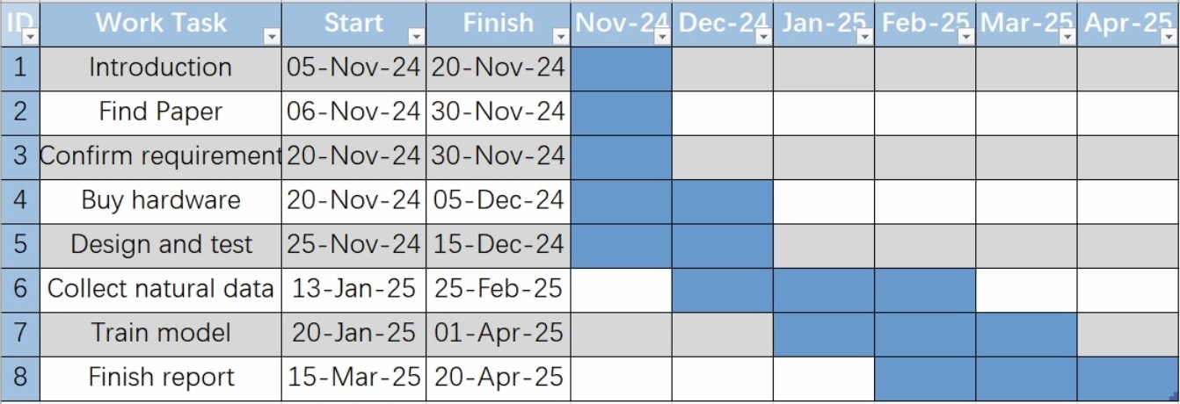
4. Management and Challenges
Time Management
Fig. 5. Gantt Chart

Slide 10
4. Management and Challenges
Type | Price | Quantity
ESP32-S3 Board | In stock | Depend on the number of sampling locations
Bread Board | In stock
Wires | In stock
Battery | ￡6.99 each
Turbidity Module | ￡6.45 each
DO Module | ￡3.08 each
TDS Module | ￡10.39 each
pH Module | ￡14.31 each
EC Module | ￡8.07 each
Materials
3D printer
Server
MCU
Several sensors [6]

Slide 11
4. Management and Challenges
Possible Challenges | Solutions
Damage to IoT equipment | Provide identification plate Regular inspection
Over budget | Reduce sampling sites
Unstable of device and connection | stable power supply Use large area coverage Wi-Fi

Slide 12
5. Conclusion
Advantages
Strong expansibility and low cost
Innovations
Using IoT devices to study pollution in London's rivers
IoT Monitoring System
Challenges
Device stability and budget control

Slide 13
Thank you!

Slide 14
Reference
[1] M. Allen, “Findings of high Thames E.coli levels discovered, as new guidance issued to rowers,” River Action UK, Mar. 27, 2024. https://riveractionuk.com/findings-of-high-thames-e-coli-levels-discovered-as-new-guidance-issued-to-rowers/
[2] “Water Quality Results,” Thames21. https://www.thames21.org.uk/water-quality-results/
[3] “‘Alarmingly high’ levels of E.coli in River Thames found days before Oxbridge Boat Race,” Sky News. https://news.sky.com/story/alarmingly-high-levels-of-e-coli-in-river-thames-found-days-before-oxbridge-boat-race-13102682
[4] Super Utilisateur, “Fluidion ALERT One,” Fluidion.com, 2024. https://fluidion.com/products/analyzers/alert-one (accessed Nov. 14, 2024).
[5] J. Fonseca-Campos, I. Reyes-Ramirez, L. Guzman-Vargas, L. Fonseca-Ruiz, J. A. Mendoza-Perez, and P. F. Rodriguez-Espinosa, “Multiparametric System for Measuring Physicochemical Variables Associated to Water Quality Based on the Arduino Platform,” IEEE Access, vol. 10, pp. 69700–69713, 2022, doi: https://doi.org/10.1109/access.2022.3187422.
[6] “Sensors - GebraBit,” GebraBit, Aug. 19, 2024. https://gebrabit.com/en/sensors/.

